Slide 1
Assessing the impacts of climate change on vulnerable populations using a health informatics approach Kavya Sri Pachchava Sesha Sai Ramineni

Slide 2
TABLE OF CONTENTS
INTRODUCTION
POPULATIONS OF CONCERN
TARGET POPULATION
IMPACTS AND INSIGHTS
MAPPING
CHALLENGES ASSOCIATED
RELATED WORK
OPPORTUNITIES FOR NEW AREAS OF RESEARCH
SUMMARY

Slide 3
Introduction
Climate change, primarily driven by human activities such as industrial pollution, deforestation, and the emission of greenhouse gases from burning fossil fuels, is an escalating global crisis that amplifies the greenhouse effect, leading to severe environmental transformations and increased global temperatures.
These changes profoundly impact weather patterns and ecosystems, resulting in increased frequency and severity of extreme weather events such as hurricanes and wildfires, disruption of species migration patterns, and loss of habitat viability, all of which have secondary effects on human populations.
The health impacts are diverse and severe rising temperatures and fluctuating conditions facilitate the spread of vector-borne diseases such as malaria, dengue, and Zika virus, particularly in warmer, tropical regions.
The World Health Organization projects that these climate-related changes will cause approximately 250,000 additional deaths annually from malaria, malnutrition, diarrhea, and heat stress between 2030 and 2050.
Notes:
Climate change is here. It’s happening. And it sucks.” said by a fisher man in up michigan Bridge Michigan the winter is going to be more rain and mud

Slide 4
Continuation…
Moreover, respiratory ailments are on the rise due to declining air quality, with an increased incidence of allergies and asthma from higher pollen counts.
Agricultural productivity is directly affected by altered rainfall patterns, increased pests, and extreme weather conditions, leading to significant fluctuations in food prices and exacerbating food scarcity, which is particularly dire in regions like Sub-Saharan Africa, South Asia, and parts of Latin America among affected communities.
Extreme weather events, including major floods and prolonged droughts, destroy homes and livelihoods, trigger widespread health emergencies, and have long-lasting impacts on local economies and health systems. Additionally, the increasing frequency and severity of heatwaves disproportionately affect the elderly, children, the chronically ill, and economically disadvantaged communities, as exemplified by historical events like Europe’s 2003 heatwave, which caused approximately 70,000 excess deaths.
The intersection of climate change and public health is thus one of the most pressing global challenges, requiring urgent, integrated, and strategic global health initiatives to mitigate these adverse effects and enhance resilience among affected communities.

Slide 5
Populations of concern
Communities of color
Low-income populations
Immigrants
Outdoor workers (farmers, agricultural workers, commercial fishermen, construction workers, paramedics, firefighters, transportation workers, etc.)
Limited English proficiency groups
Children
Pregnant women
Persons with disabilities
Notes:
Vulnerable groups of people are described as populations of concerns.

Slide 6
Target population
PREGNANT WOMEN:
Pregnant women and their foetuses are even more vulnerable than the general population to the health impacts of climate change.
Climate-related exposures may lead to adverse pregnancy and newborn health outcomes, including spontaneous abortion, low birth weight (less than 5.5 pounds), preterm birth (birth before 37 weeks of pregnancy), increased neonatal death, dehydration and associated renal failure, malnutrition, diarrhea, and respiratory disease.
The rate of preterm births is relatively high in the United States (1 of every 9 infants born), where they contribute substantially to neonatal death and illness. Of the 1.2 million preterm births estimated to occur annually in high-income countries, more than 500 thousand (42% of the total) occur in the United States.
In 2007, the Intergovernmental Panel on Climate Change (IPCC) presented a large body of evidence supporting the presence of global warming and its impact on global climate. The report highlighted that a child born today will be living in an environment that is more than four degrees warmer than the average temperature during the preindustrial period and will experience significantly more frequent and intense environmental disasters such as heatwaves, wildfires, and hurricanes.
Notes:
Preterm birth which is also called as premature birth, is when a baby is born before 37 weeks of pregnancy.
Neonatal death is the death of an infant within the first 28 days of birth.

Slide 7
Continuation…
Extreme heat events have been associated with adverse birth outcomes such as low birth weight, preterm birth, and infant mortality, as well as congenital cataracts.
In addition, exposure of pregnant women to inhaled particulate matter is associated with negative birth outcomes. Incidences of diarrheal diseases and dehydration may increase in extent and severity, which can be associated with adverse effects on pregnancy outcomes and the health of newborns.
Floods are associated with an increased risk of maternal exposure to environmental toxins and mold, reduced access to safe food and water, psychological stress, and disrupted health care.
Other flood-related health outcomes for mothers and babies include maternal risk of anemia (a condition associated with low red blood cell counts sometimes caused by low iron intake), eclampsia (a condition that can cause seizures in pregnant women), and spontaneous abortion.

Slide 8
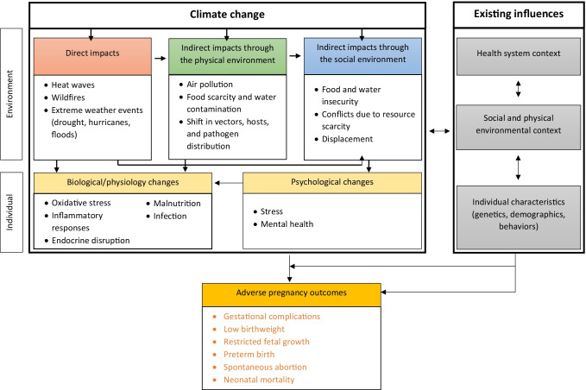
Fig.1 Impacts of climate change on pregnancy outcomes

Slide 9
IMPACTS
EXTREME WEATHER EVENTS:
The frequency and intensity of extreme weather events such as hurricanes and floods are expected to increase. Hurricanes reduce access to safe food and water and induce stress by disrupting existing infrastructures.
During a hurricane, pregnant women report significant fear of losing their home and/or job and serious concerns about the health of their baby and the birth process.
Those with severe hurricane experience also report a higher frequency of mental health complications such as PTSD and depression, which are all major risk factors for subsequent adverse perinatal outcomes.
Studies suggest that women with prenatal hurricane experience have a greater risk of hypertensive disorders of pregnancy, labor and birth complications, C-sections, and newborn complications. Increased risk of preterm birth and low birth weight is also reported, but these findings are less consistent in part due to high heterogeneity between studies.

Slide 10
INSIGHTS
More recently, Xiao et al. 2021 reported that Hurricane Sandy (New York, 2012) was associated with a 4.1% increased rate of emergency department (ED) visits within 1 week for eight major pregnancy complications. The authors also found that the rate of ED visits for pregnancy complications increased by 16.6% within 7 days after a power outage. Duration and severity of power outages were also related to risk.
Similarly, Pan et al. 2021 reported that exposure to Hurricane Michael (Florida, 2018) was associated with a 39% increased risk of delivering a small gestational age baby, and a 19% increased risk of having inadequate prenatal care, suggesting that disruption to prenatal care may be a pathway to pregnancy risk.
A prospective study of a subsequent Red River Flood (North Dakota, 2009) found that women who lived closer to the flood during the first trimester had significantly smaller babies (i.e., − 43 g per mile).
Similarly, women who were displaced by the 2011 Thailand flood had babies on average 175 g lower compared to unaffected women.
Notes:
Small gestational age baby= a baby that is smaller than normal for the number of weeks of pregnancy.

Slide 11
Continuation…
2. FOOD AND WATER QUALITY AND AVAILABILITY:
Extreme climate-related disasters decrease crop productivity, kill livestock, increase food spoilage, and slow food supply distribution, all of which can lead to food insecurity and malnutrition.
In many parts of the world, food scarcity is already a significant public health problem, especially for pregnant women from lower socioeconomic positions.
Food insecurity is associated with the risk of major birth defects (e.g., cleft palate, dextro-transposition of the great arteries, tetralogy of Fallot, spina bifida, and anencephaly), low birth weight, preterm labor, gestational diabetes, and gestational hypertension.
In areas without proper refrigeration, extreme weather events can increase the opportunity for food spoilage, leading to the risk of foodborne illness in pregnant women and ultimately adverse pregnancy complications.

Slide 12
Mapping
GEOGRAPHIC INFORMATION SYSTEMS (GIS)
The use of geographic data and tools allows for more sophisticated mapping of risk factors and social vulnerabilities to identify and protect specific locations and groups of people.
It is a data management system used to capture, store, manage, retrieve, analyze, and display geographic information can be used to quantify and visualize factors that contribute to climate-related health risks.
By linking together census data, data on the determinants of health (social, environmental, preexisting health conditions), measures of adaptive capacity (such as healthcare access), and climate data, GIS mapping helps identify and position resources for at-risk populations.
Mapping serves as a decision support tool for public health planning, emergency response, and policy development.
Temporal analysis in mapping allows tracking changes over time, seasonal variations, trends, and long-term impacts of climate change on vulnerable populations.

Slide 13
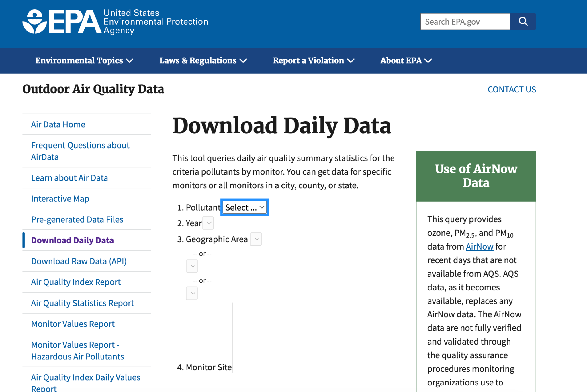
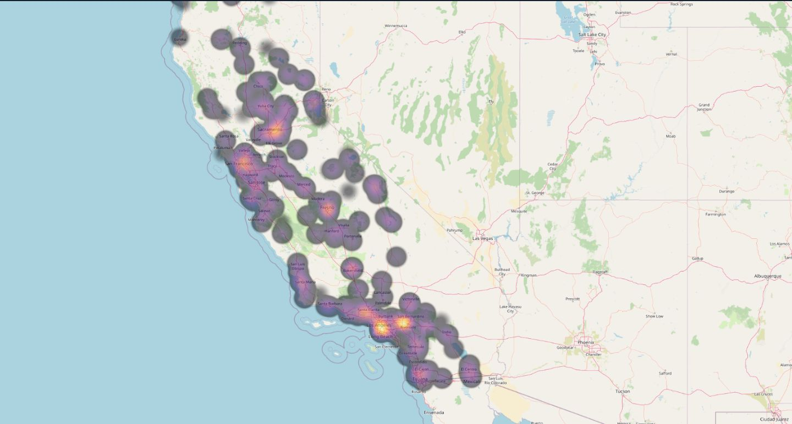
Continuation
PM2.5: 5 μg/m3 annually
NO2: 10 μg/m3 annually
CO: 26 parts per million (ppm) for the maximum 1-hour average concentration; and 9 ppm for the maximum 8-hour average concentration.
Notes:
We can notice excess of air pollutants in the region of -
Sacramento
San Francisco
Fresno
Santa Clarita
Los Angeles
Riverside
San Bernardino

Slide 14
CHALLENGES ASSOCIATED
DATA AVAILABILITY AND QUALITY:
Security of data: In many regions, especially in developing countries, there is a lack of reliable health data and environmental monitoring, which makes it difficult to establish clear cause-and-effect relationships between climate change and health outcomes.
Data standardization: There is often a lack of uniformity in how data is collected and reported across different countries and regions. This inconsistency can hinder the aggregation and comparison of data, which is crucial for global studies on climate impacts.
2. INTEGRATION OF DIVERSE DATA TYPES:
Multidisciplinary inputs: Climate change health informatics requires the integration of data from various fields such as meteorology, geography, public health, and socioeconomics. Combining these datasets, which often use different scales and formats, poses significant technical and methodological challenges.
Real-time Data Processing: The need to process and analyze large volumes of real-time data from various sources (e.g., satellite images, weather stations, and healthcare records) demands robust computational tools and advanced analytics capabilities.

Slide 15
Continuation
3. Privacy and Security Concerns:
Sensitive Information: Health data is highly sensitive. Collecting, storing, and analyzing this data must comply with strict privacy laws and regulations, such as GDPR in Europe or HIPAA in the United States.
Data Security: Ensuring the security of health data against breaches and unauthorized access is crucial, especially when integrating data across borders and platforms.
Adaptation and Scalability Challenges:
Scalable Solutions: Developing health informatics solutions that are adaptable to different regions with varying levels of infrastructure and resources is a significant challenge.
Future-Proofing: With the rapid pace of climate change, solutions must not only address current challenges but also be adaptable to future scenarios, which can be difficult to predict accurately.
Funding:
Limited Funding: Research in climate health informatics is often underfunded, especially in countries that are most affected by climate change but have the least resources to combat its impacts.

Slide 16
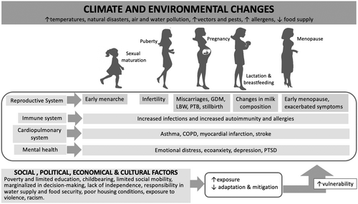
RELATED WORK
Girardi, G. and Bremer, A.A., 2024. Climate and environmental changes exacerbate health disparities in pregnant people and their offspring. How can we protect women and their babies?. Birth Defects Research, 116(2), p.e2313.

Slide 17
Continuation
The article in 'Birth Defects Research' discusses how climate and environmental changes are exacerbating health disparities among pregnant individuals, especially those in less advantaged communities. The authors argue that these populations are more susceptible to adverse outcomes from such changes, highlighting the need for comprehensive policies and programs aimed at mitigating risks. The article stresses the importance of political and economic empowerment, education, and inclusivity in policy-making to safeguard the health of women and future generations against the backdrop of climate change.

Slide 18
Opportunities for new areas of research
Identifying emerging public health issues related to climate change and maternal health (environmental exposures, changing disease patterns, or socio-economic determinants affecting pregnant women’s health).
Investigate the role of precision health approaches such as personalized medicines, or by utilizing digital health technologies in predicting and managing climate-associated health outcomes for pregnant women.
Focussing on predictive modeling, risk assessment tools, and early warning systems for climate-related health risks during pregnancy.
Conducting cost-benefit analyses of interventions aimed at reducing the impact of climate change on these populations
Assessing the effectiveness of mental health interventions in the aftermath of climate-related disasters.
Investigating the impact of educational programs on improving climate change literacy and promoting proactive health behaviors

Slide 19
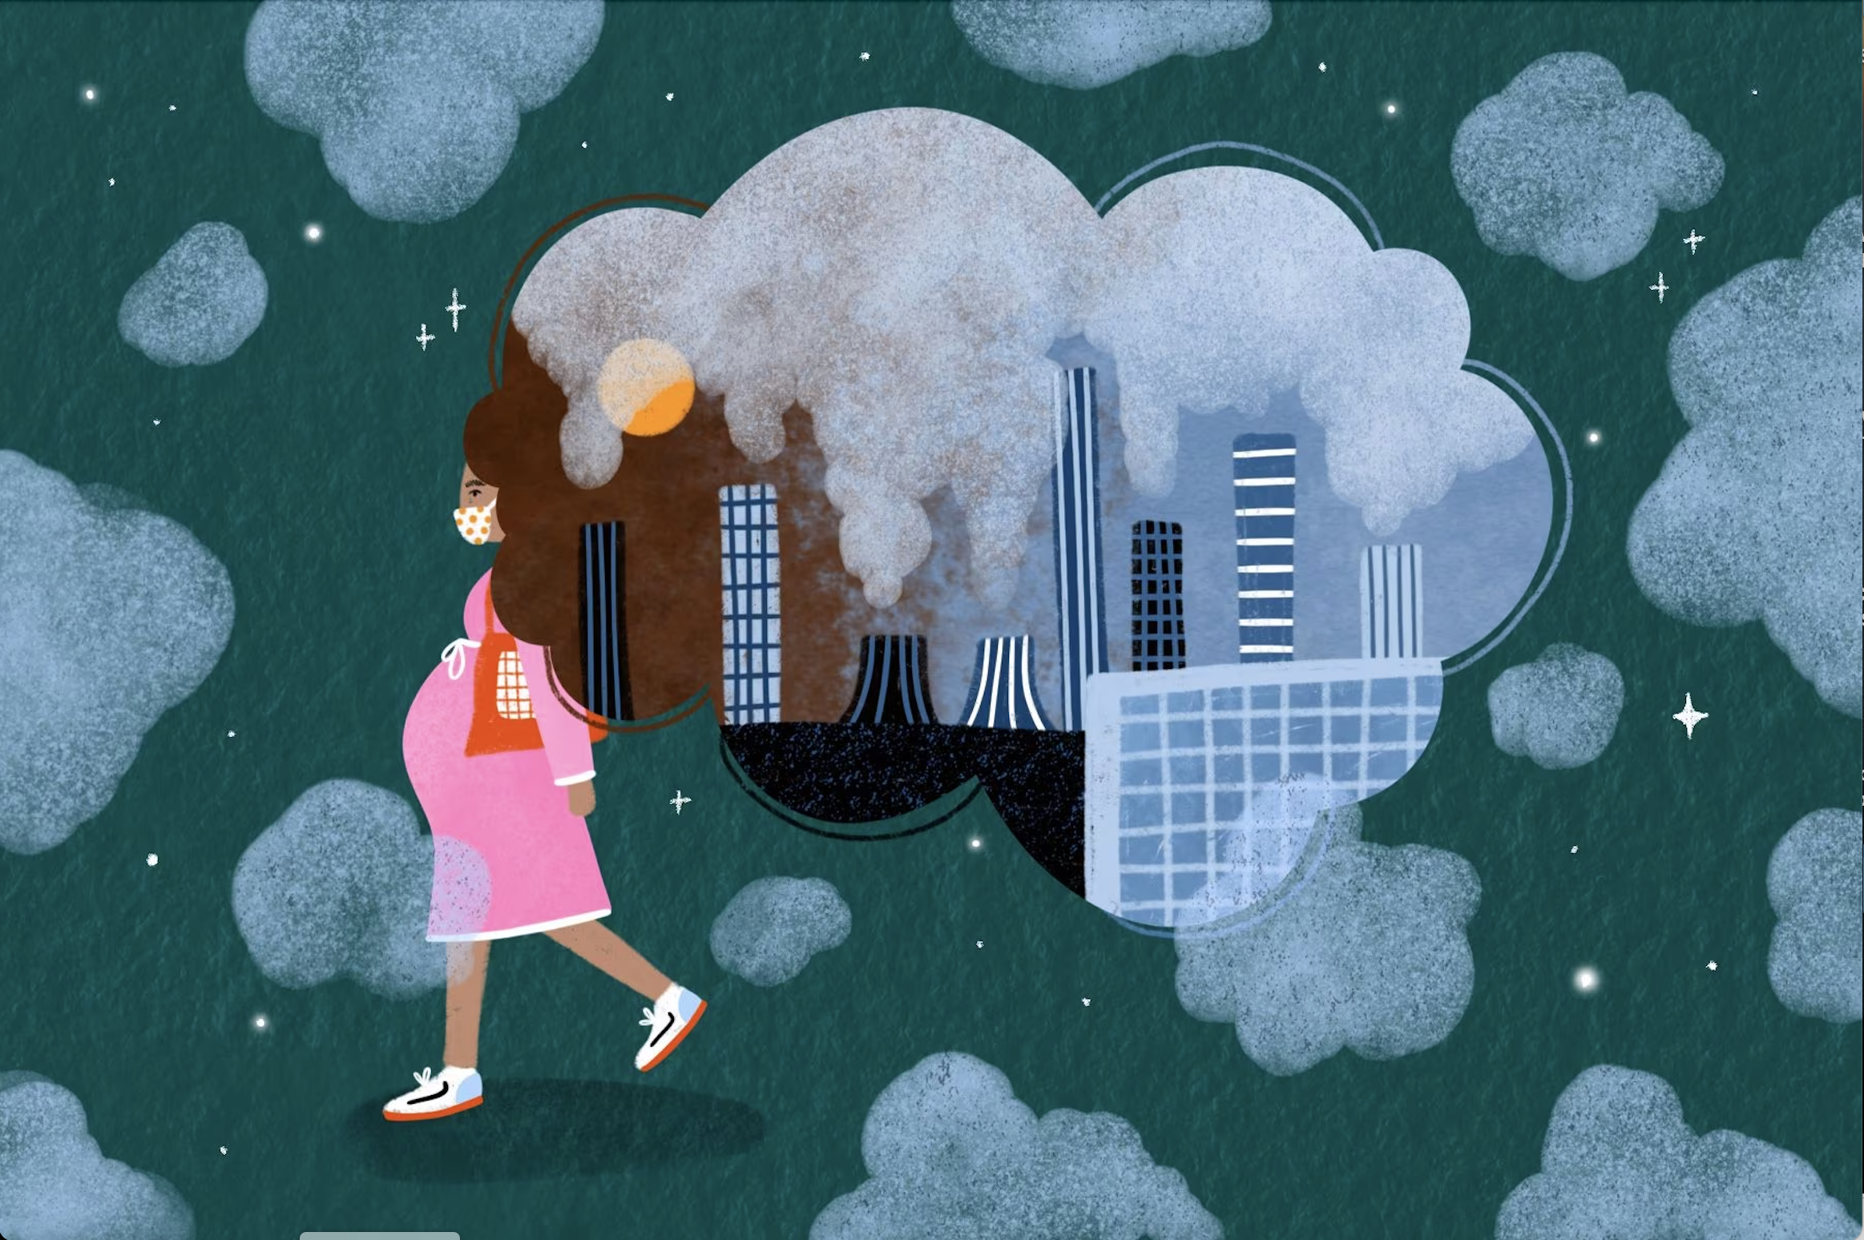
SUMMARY
In conclusion, Prevention provides protection i.e., public health actions especially preparedness and prevention, can do much to people from some impacts of climate change. Early actions provides the larger benefits.
Apart from that, responding to climate change provides opportunities to improve human health and well-being across many sectors, including agriculture, transportation etc. Many of these strategies offer a variety of benefits, protecting people while combating climate change and providing other social benefits.

Slide 20
References
1. Moda, H.M., Filho, W.L. and Minhas, A., 2019. Impacts of climate change on outdoor workers and their safety: some research priorities. International journal of environmental research and public health, 16(18), p.3458.
2. Rylander, C., Øyvind Odland, J. and Manning Sandanger, T., 2013. Climate change and the potential effects on maternal and pregnancy outcomes: an assessment of the most vulnerable–the mother, foetus, and newborn child. Global health action, 6(1), p.19538.
3. Richards, J., Fraser, H. and Douglas, G., 2020. Perspectives on global public health informatics. Public Health Informatics and Information Systems, pp.459-480.
4. Ha, S., 2022. The changing climate and pregnancy health. Current environmental health reports, 9(2), pp.263-275.
5. -Gray, K., 2022. Climate change, human health, and health informatics: a new view of connected and sustainable digital health. Frontiers in Digital Health, 4, p.869721.

Slide 21
References
6. Ha S. The Changing Climate and Pregnancy Health. Curr Environ Health Rep. 2022 Jun;9(2):263-275. doi: 10.1007/s40572-022-00345-9. Epub 2022 Feb 22. PMID: 35194749; PMCID: PMC9090695.
7. Effects of air pollution on adverse birth outcomes and pregnancy complications in the US state of Kansas (2000–2015)
Hao, H., Yoo, S.R., Strickland, M.J., Darrow, L.A., D’Souza, R.R., Warren, J.L., Moss, S., Wang, H., Zhang, H. and Chang, H.H., 2023. Effects of air pollution on adverse birth outcomes and pregnancy complications in the US state of Kansas (2000–2015). Scientific Reports, 13(1), p.21476.
8.https://health2016.globalchange.gov/populations-concern#narrative-134
9. Real-time data for the air pollution from EPA
https://www.epa.gov/outdoor-air-quality-data/download-daily-data

Slide 22
Thanks!

